Slide 1
Bellabeat Case Study
How Can a Wellness Technology Company Play It Smart?
Cap Stone Google Data Analytics Case Study
Author : Sulay Cay
Date: 05-Jan-2025

Slide 2
Introduction
The Bellabeat case study focuses on analyzing Fitbit smart device data to uncover trends and provide actionable insights for marketing strategies.

Slide 3
Key Business Questions
1. What are the trends in smart device usage?
2. How can these trends apply to Bellabeat products?
3. How can these insights help influence Bellabeat's marketing strategy?

Slide 4
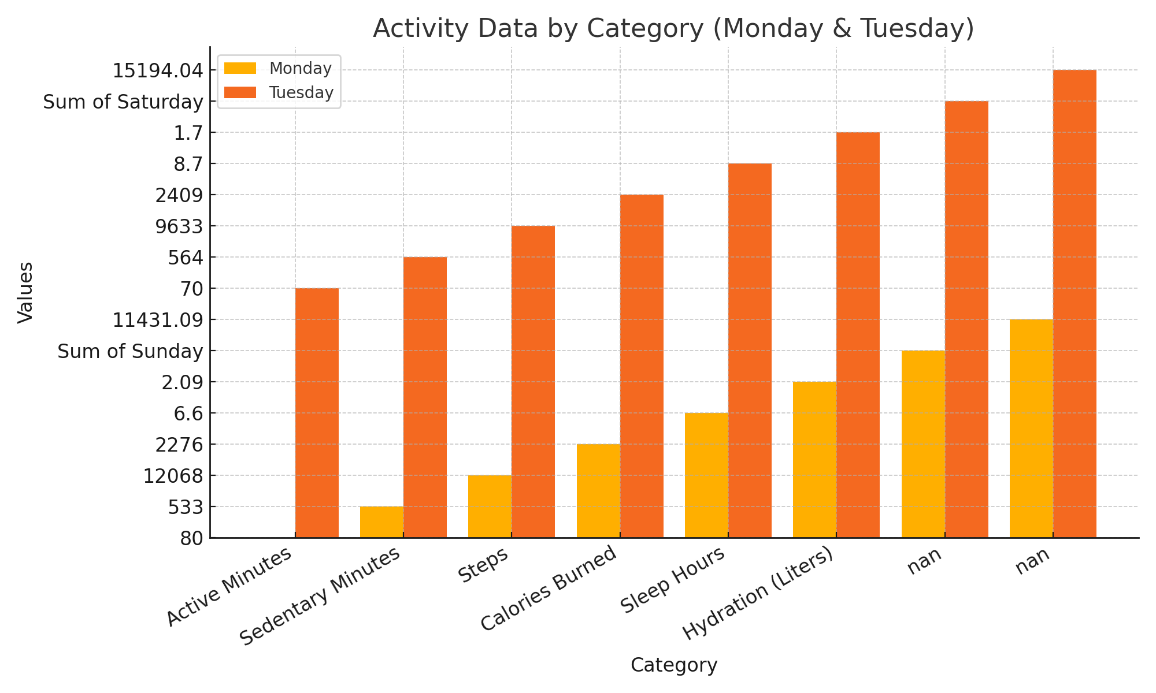
Activity Data Visualization (Monday & Tuesday)

Slide 5
Data Analysis Summary
The dataset reveals:
- Active Minutes: High activity on weekdays compared to weekends.
- Sleep Patterns: Average sleep hours align with wellness goals.
- Hydration: Consistent hydration levels among users.
These insights can guide Bellabeat in targeting user habits.

Slide 6
Random Data Insights
The dataset includes various metrics such as Active Minutes, Sedentary Minutes, Steps, Calories Burned, Sleep Hours, and Hydration across days of the week.

Slide 7
Recommendations
Promote activity-based challenges within the Bellabeat app.
1
Highlight features for tracking active minutes and sleep insights.
2
Showcase the Spring water bottle for hydration tracking.
3
Leverage weekly trends for targeted marketing campaigns.
4

Slide 8
Conclusion and Recommendations
Bellabeat's analysis of smart device data uncovers valuable trends and user behaviors, offering actionable insights. By utilizing this information, Bellabeat can refine its products and marketing strategies to align more closely with the needs of its target audience. Future plans include introducing personalized challenges and emphasizing features like hydration and sleep tracking. Additionally, prioritizing comfort and ease of use will be crucial, as users highly value wearable devices that are both comfortable and user-friendly.

